Slide 1
Dominican Republic Update
Tift College of Education
Board of Visitors
N. Jean Walker
Cynthia Anderson
November 3, 2023

Slide 2
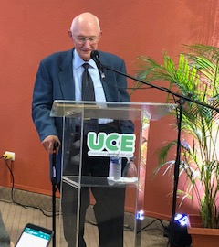
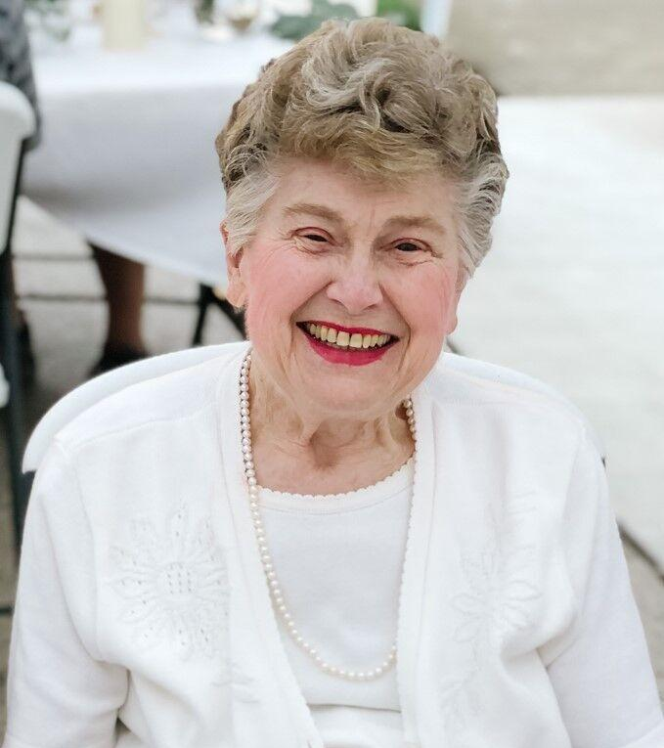

Slide 3
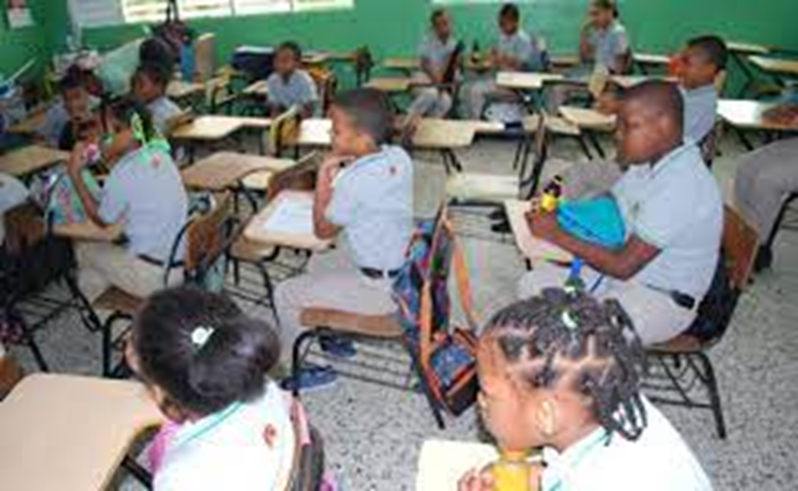
Mercer Models – Instructional Strategies
Created by Tift College of Education Faculty
Developed based upon teacher/instructional needs and gaps after many DR classroom observations
Research-based instructional strategies designed to improve teacher instruction to increase student learning and achievement
Three key areas of instructional strategy focus:
Planning and organizing Instruction
Student learning and engagement
Creating a supportive and engaging learning
environment

Slide 4
Continuous Improvement: Lessons Learned
“Everything Rises and Falls on Leadership” – John Maxwell
Sustainability of the DR Project depended upon:
*Building the capacity of school leaders to become instructional leaders
*Support and involvement of the Dominican Republic Ministry of Education
*Support from Mercer University and Tift College of Education
*Support from the McDonald Center for the Advancement of Global Education
*Ongoing teacher professional development

Slide 5
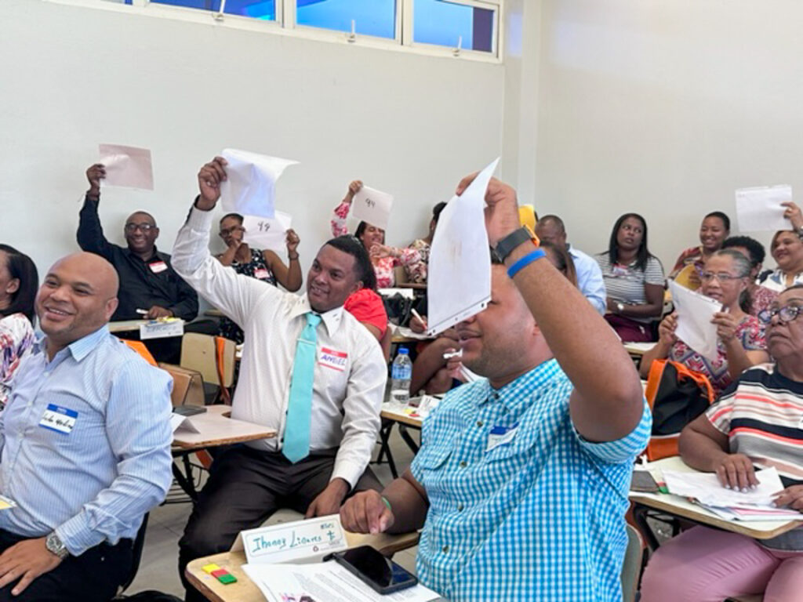
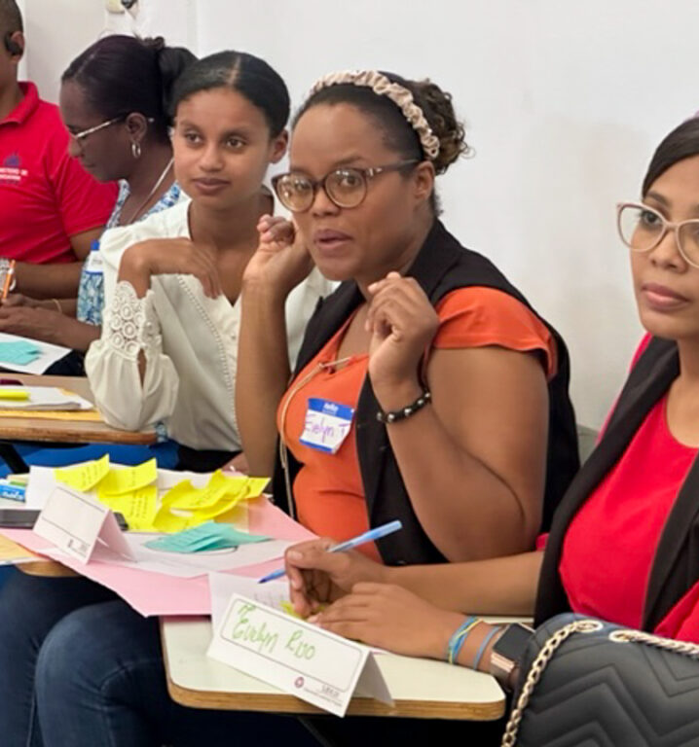

Slide 6
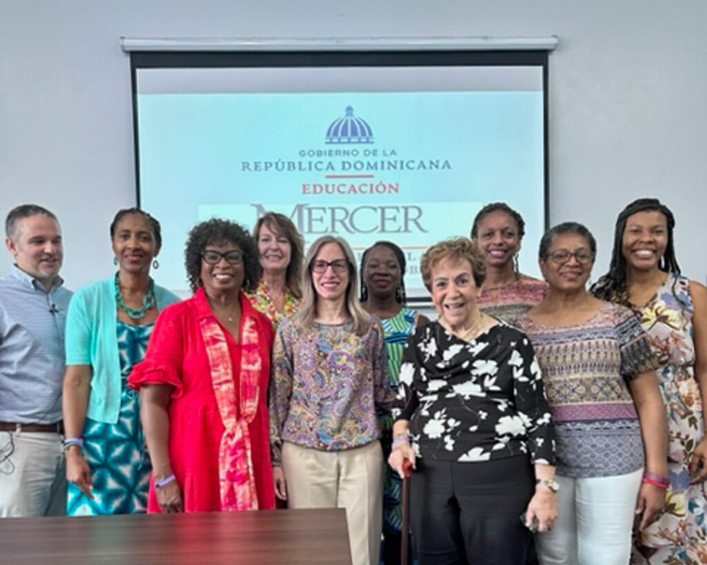

Slide 7
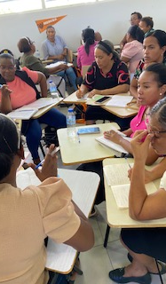
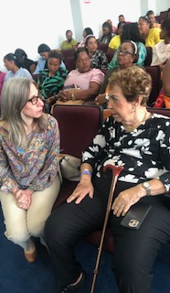
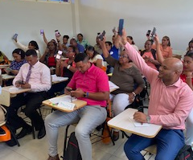
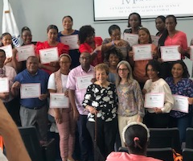

Slide 8
