Slide 1
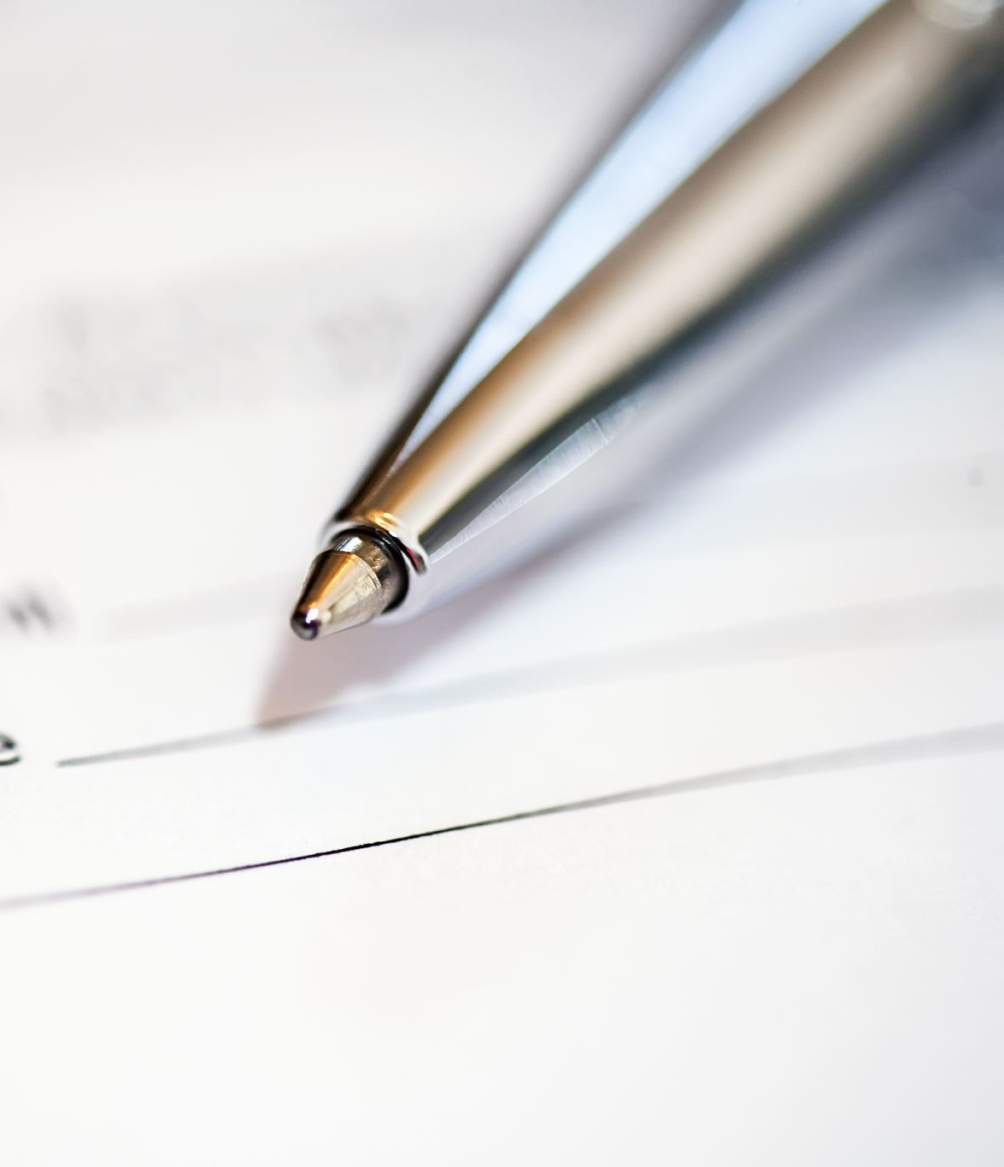
How to Purchase a New or Renewal Code for Anthology

Slide 2
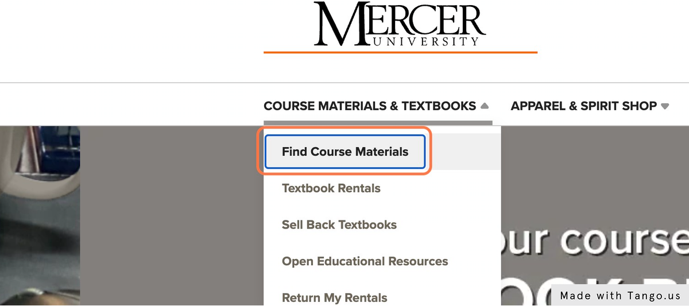
Steps 1 & 2
1. Go to Mercer University Bookstore Website
https://mercer-macon.bncollege.com/
2. Click on Find Course Materials (under Course Materials & Textbooks)

Slide 3
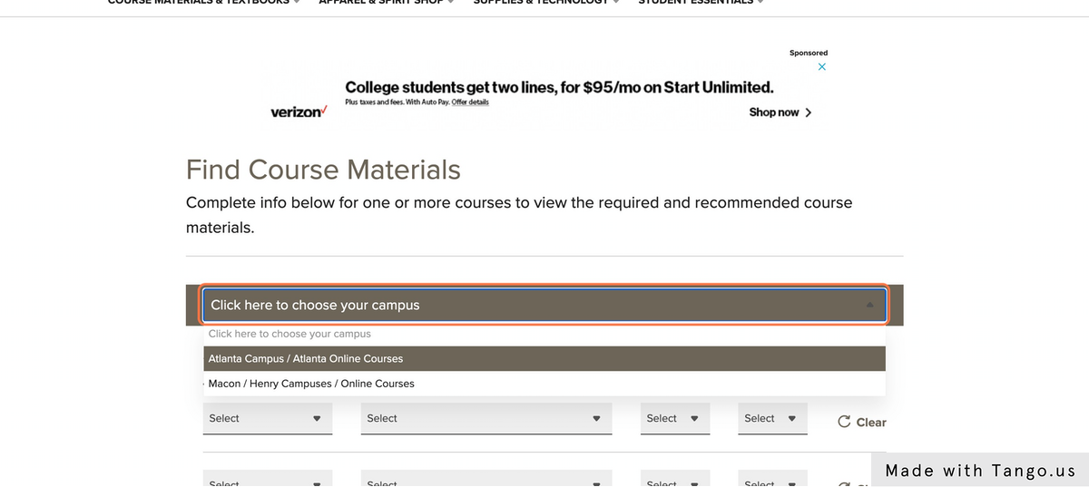
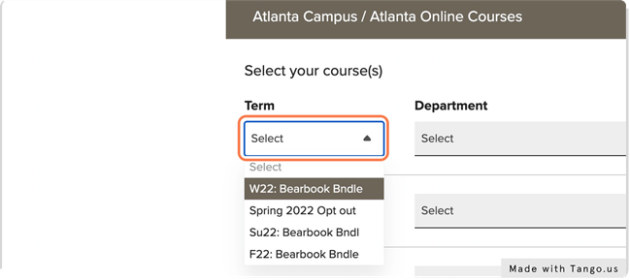
Steps 3 & 4
3. Click on Click here to choose your campus & select either campus
4. Click on Term to select the term you are purchasing for

Slide 4
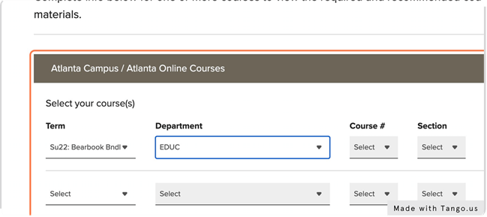
Steps 5 & 6
5. Under Department: Scroll to or Type EDUC
6. Under Course #: Scroll to bottom and Click ANTHOLOGY

Slide 5
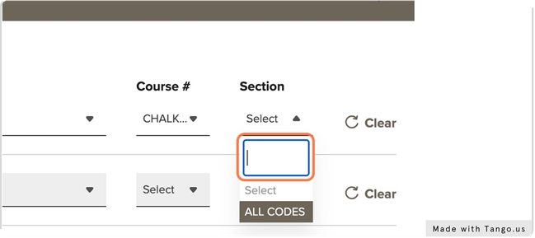
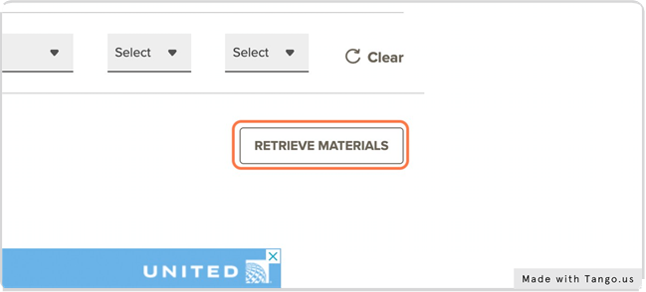
Steps 7 & 8
7. Under Section: Select ALL CODES
8. Click RETRIEVE MATERIALS

Slide 6
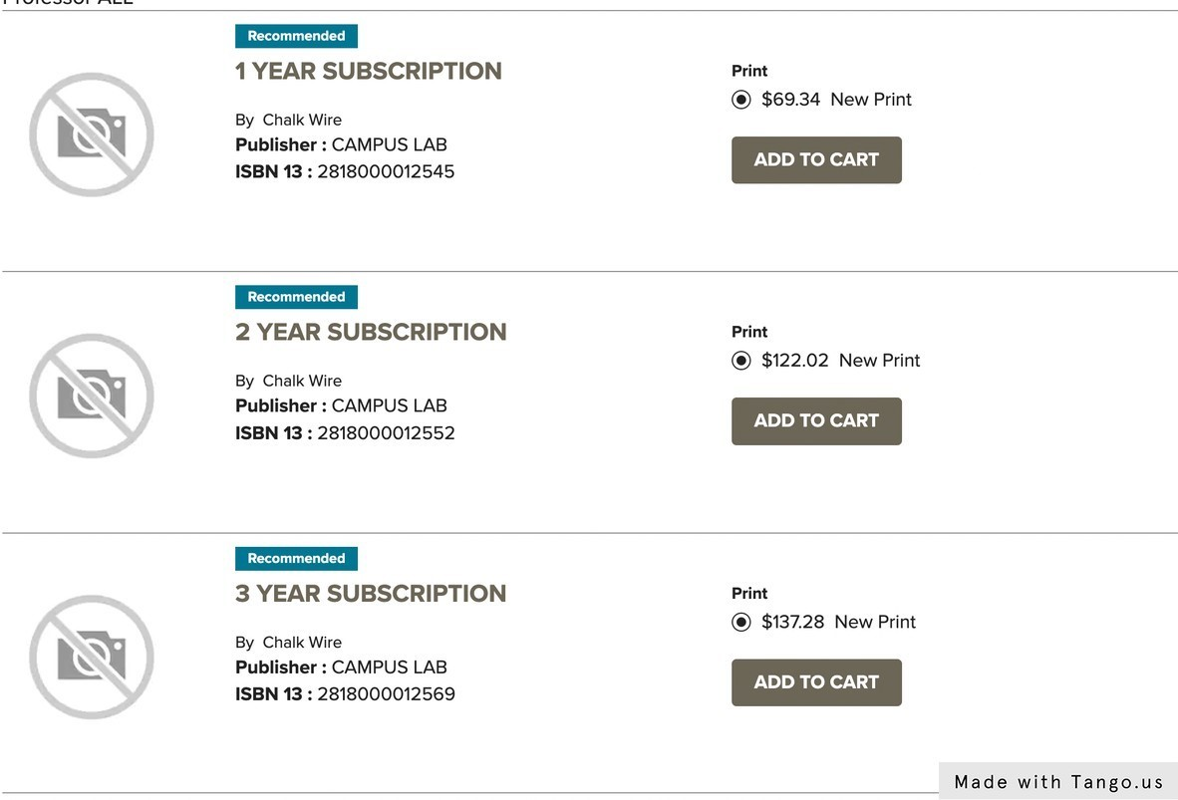
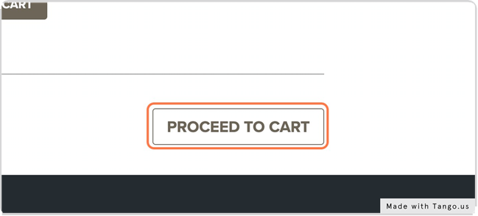
Steps 9 & 10
9. Select 1-, 2-, or 3-year subscription option & Click ADD TO CART
10. Click PROCEED TO CART

Slide 7
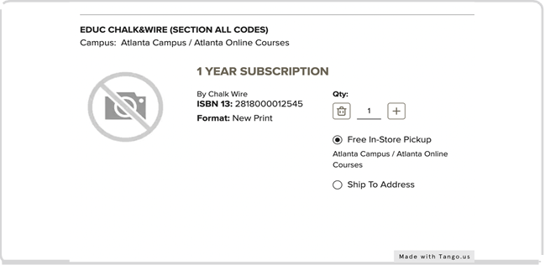
Final Step
11. At Checkout you must select In Store Pickup and complete your purchase
*Note: Codes are emailed from the bookstore to the email address associated with your Mercer Bookstore Account. This process may take a few days. Continue to check your inbox, spam, and junk mail until the code is received. If you receive a code that does not work or is invalid, please contact the Macon campus bookstore at 478-301-2945 for assistance.

Slide 8
Further Help
There is no longer a difference between purchasing a registration or renewal code. All codes may be used to create, renew, or upgrade a user account. Once you have received your code via email from the Mercer bookstore, you will need to follow the steps in the following link to register your new account or renew your expired account.
Renew Your Account
Register your Account
If you need further assistance, please refer to your instructor or contact the Tift Tech Support Helpdesk: tifttechsupport@mercer.edu

