Slide 1
How to login into your MyPSC Account
Go to www.gapsc.com
Click
here
to login into your MyPSC account

Slide 2
Enter in your email address and password

Slide 3
Click on Assessments

Slide 4
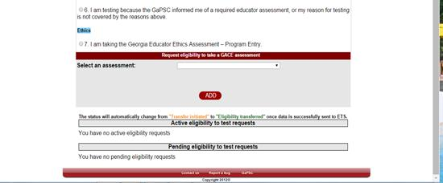
Choose an option from questions
1, 2, 3, or 7

Slide 5
Question #1

Slide 6
Question #2

Slide 7
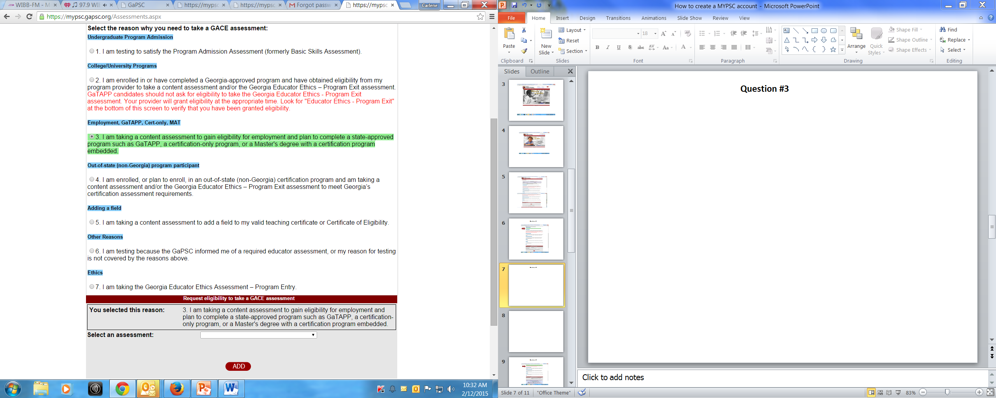
Question #3

Slide 8
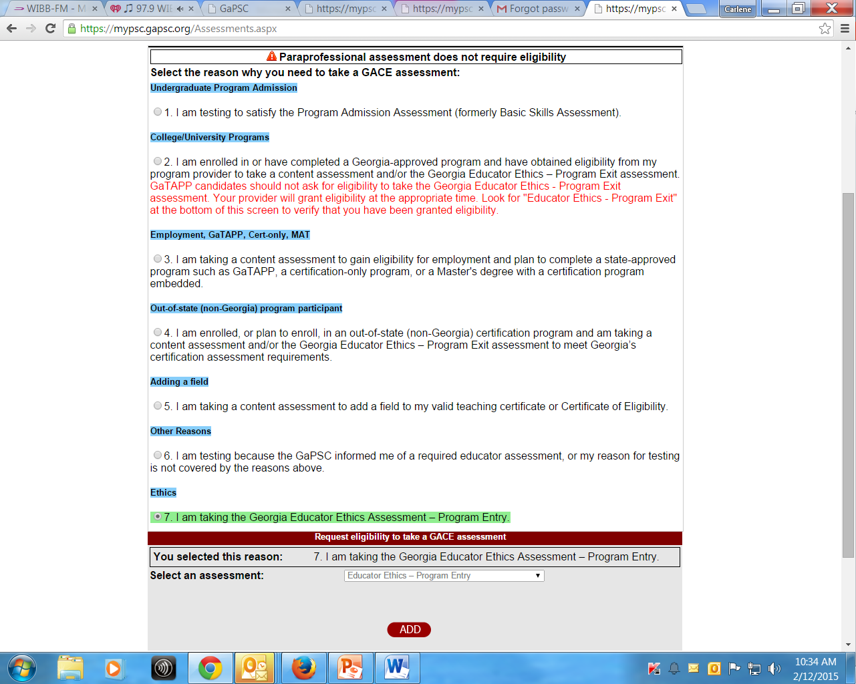
Question #7

